Slide 1


Slide 2

Let’s Play

Slide 3
Guess the last result
1+2=6
2+3=15
3+4=28
4+5=?

Slide 4
What is AI?

Slide 5
Classic Def
Alan Turing's "The Imitation Game" (1950): "Can machines think?" This opened the debate about machine intelligence by proposing the Turing test, where a machine indistinguishable from a human in conversation is considered intelligent.
John McCarthy's "What is Artificial Intelligence?" (1955): "The study of how to make computers do things which, at the present time, can only be done by humans." This highlights AI's goal of replicating human-like problem-solving and thought processes.

Slide 6
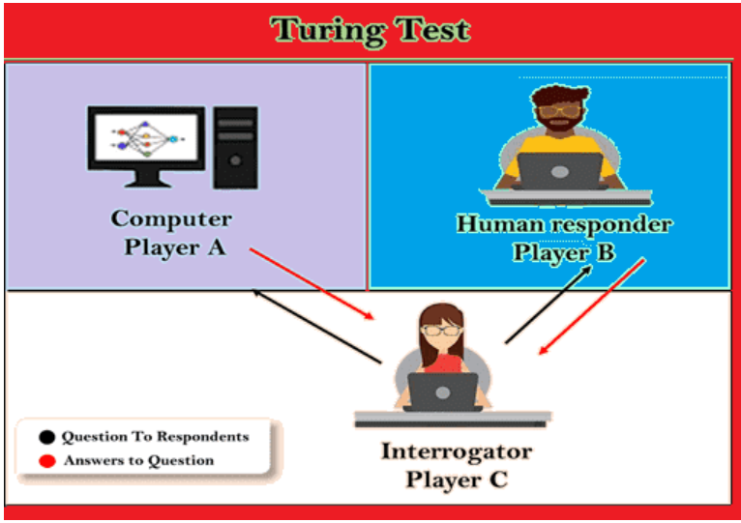
Can Machines Think
Alan Turing's "The Imitation Game" (1950): "Can machines think?" This opened the debate about machine intelligence by proposing the Turing test, where a machine indistinguishable from a human in conversation is considered intelligent.

Slide 7
Modern Def
Artificial General Intelligence (AGI): "The hypothetical ability of an AI to understand or learn any intellectual task that a human can." This captures the ultimate goal of some AI research, creating machines with comprehensive human-like intelligence.
Narrow AI: "Intelligence focused on a specific task or domain, like playing chess or recognizing faces." This reflects the current state of most AI applications, excelling in specific areas but not possessing general intelligence.
Demis Hassabis' "A Goal for Artificial Intelligence": "To create artificial intelligence that can understand and reason about the world as well as people, and use that knowledge to achieve specific goals." This focuses on building AI that understands and interacts with the world like humans do.

Slide 8
AI & Human Development
• Blank slate: Both start knowing nothing (neural networks, initial weights, genetic predisposition)
• Pattern learning: Humans observe life, AI processes data (supervised learning, real-world experience, training datasets)
• Growth by feedback: Both improve through correction (reinforcement learning, trial-error, reward systems)
• Generalization: Both apply learning to new situations (transfer learning, cognitive flexibility, adaptive responses)
• Specialization: Both develop focused expertise (deep learning models, neural plasticity, domain expertise)

Slide 9
History of AI?

Slide 10
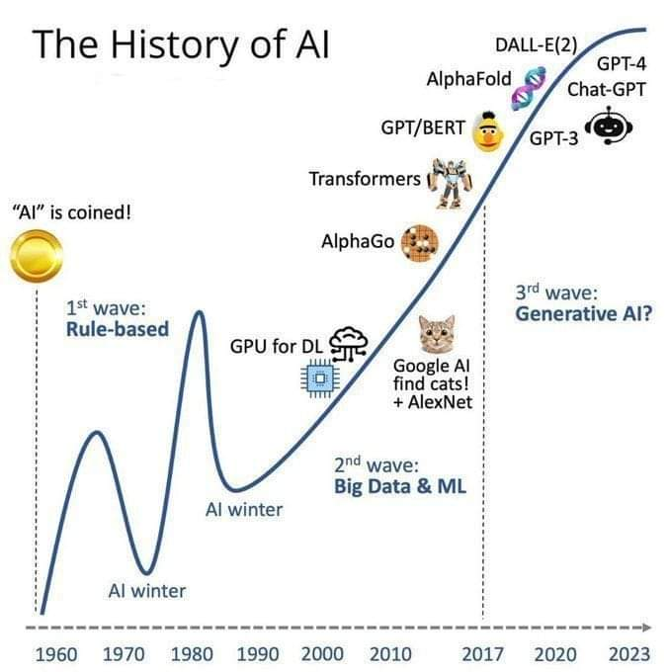

Slide 11
History of Ai
1950s - Birth of AI:
- Alan Turing introduces the Turing Test in 1950, a concept to evaluate a machine's ability to exhibit human-like intelligence.
- The term "Artificial Intelligence" is coined by John McCarthy in 1956 at the Dartmouth Conference.
1960s - Symbolic AI and Expert Systems:
- Early AI systems focus on symbolic reasoning and problem-solving.
- Research on expert systems begins, aiming to emulate human expertise in specific domains.

Slide 12
History of Ai
1970s - Knowledge-Based Systems and Lighthill Report:
- AI research shifts towards knowledge-based systems.
- The Lighthill Report (1973) in the UK leads to reduced funding for AI research due to unmet expectations.
1980s - Expert Systems Boom and AI Winter:
- Expert systems gain popularity, with applications in medicine, finance, and engineering.
- AI Winter begins as progress falls short of expectations, leading to decreased funding.

Slide 13
History of Ai
1990s - Machine Learning Renaissance:
- Machine learning, particularly neural networks, experiences a resurgence.
- Reinforcement learning gains attention.
- IBM's Deep Blue defeats Garry Kasparov in chess (1997).
2000s - Big Data and Deep Learning:
- Increased computational power and availability of large datasets boost machine learning.
- Deep learning, fueled by neural networks with many layers, achieves breakthroughs in image and speech recognition.

Slide 14
History of Ai
2010s - Rise of Practical AI Applications:
- AI applications become mainstream with virtual assistants (e.g., Siri, Alexa).
- DeepMind's AlphaGo defeats world champion Lee Sedol in Go (2016).
- AI-powered technologies impact various industries, including healthcare and finance.
2018 - Transformer Architecture and GPT-2:
- Transformer architecture, a breakthrough in natural language processing, gains prominence.
- OpenAI introduces GPT-2, a large-scale language model (2019).

Slide 15
History of Ai
2020s - Continued Advances and Ethical Considerations:
- AI applications continue to evolve, with advancements in autonomous vehicles, robotics, and healthcare.
- Growing focus on ethical considerations, responsible AI, and addressing bias in AI algorithms.

Slide 16
Evolution of Computing and AI Infrastructure (1950s-Present)
Early Computing Era (1950s-1960s)
Limited computational resources and mainframes
Batch processing systems
Early development of programming languages

Slide 17
Evolution of Computing and AI Infrastructure (1950s-Present)
Personal Computing Revolution (1980s-1990s)
Rise of personal computers and democratization of computing
Advanced database management systems
Beginning of distributed computing
Introduction of early neural networks

Slide 18
Evolution of Computing and AI Infrastructure (1950s-Present)
Digital Transformation (2000s)
GPU revolution enabling parallel processing
Big data emergence and analytics
Internet-scale computing
Cloud computing foundations

Slide 19
Evolution of Computing and AI Infrastructure (1950s-Present)
AI Acceleration (2010s)
Specialized AI hardware (TPUs, NPUs)
Cloud computing maturity
Deep learning breakthroughs
Distributed computing frameworks

Slide 20
Evolution of Computing and AI Infrastructure (1950s-Present)
Modern Era (2020s)
AI-specific hardware acceleration
Edge computing and IoT integration
Quantum computing developments
Focus on AI ethics and responsibility
Green computing initiatives
Hybrid cloud solutions

Slide 21
History of Ai Read more:
https://jaylatta.net/history-of-ai-from-winter-to-winter/

Slide 22
DS/AI/ML/DL

Slide 23
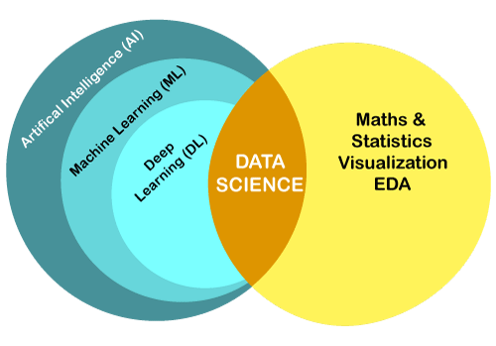

Slide 24
Artificial Intelligence (AI)
The broadest concept, encompassing the ability of machines to exhibit intelligent behavior.
It's like an umbrella term covering various approaches to achieving intelligence in machines.
ML and DL are specific techniques used to create AI systems.

Slide 25
Machine Learning (ML)
A subfield of AI that allows machines to learn from data without explicitly being programmed.
It involves algorithms that can identify patterns and relationships in data, enabling them to make predictions or decisions.
ML powers many AI applications, including image recognition, spam filtering, and recommendation systems.

Slide 26
Deep Learning (DL)
A subfield of ML inspired by the structure and function of the human brain.
It uses artificial neural networks with multiple layers to learn complex patterns from large amounts of data.
DL excels in tasks like image and speech recognition, natural language processing, and game playing (Complex patterns).

Slide 27
Data Science
A broader field that encompasses the entire process of extracting knowledge and insights from data.
It involves collecting, cleaning, analyzing, and visualizing data to solve problems and make informed decisions.
Data scientists play a crucial role in providing the high-quality data that ML and DL algorithms need to function effectively.

Slide 28
Machine
Learning

Slide 29
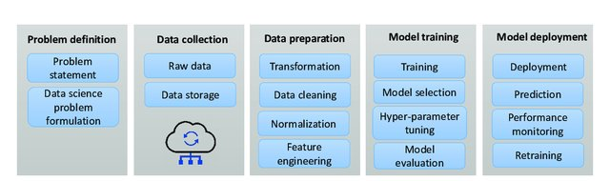
Steps in a machine learning pipeline

Slide 30
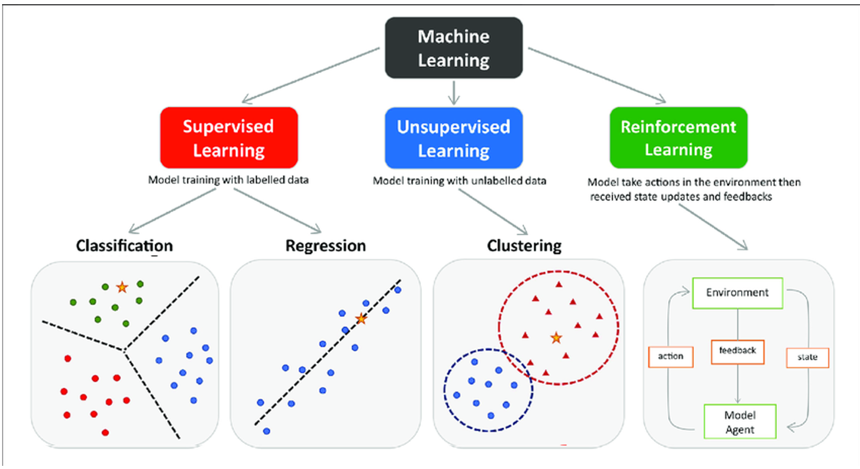

Slide 31
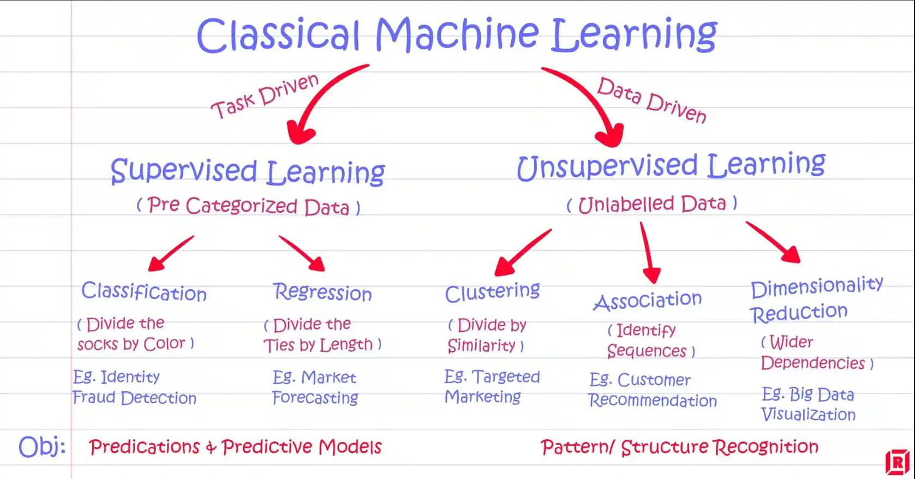

Slide 32
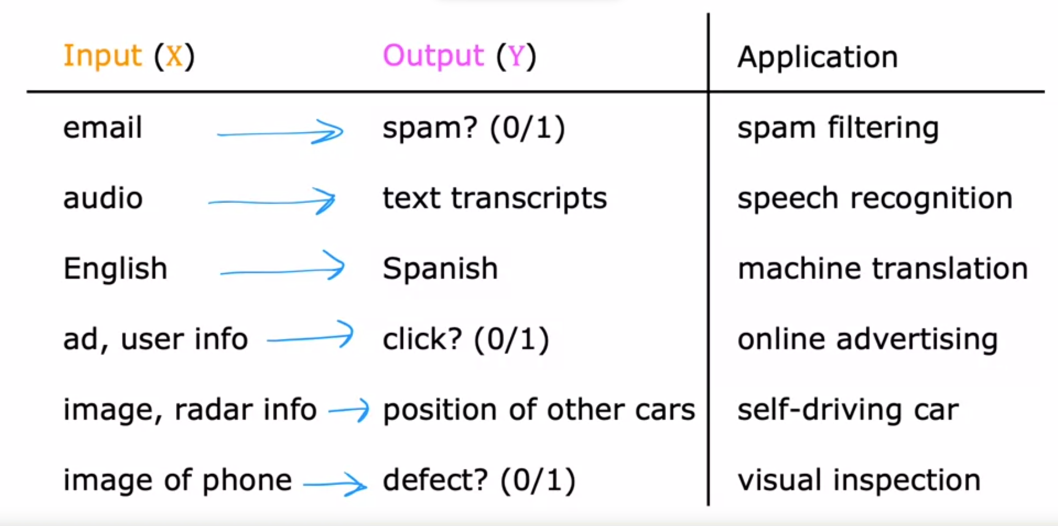
Supervised learning
Learning from being given “right answers”
Labeled data

Slide 33
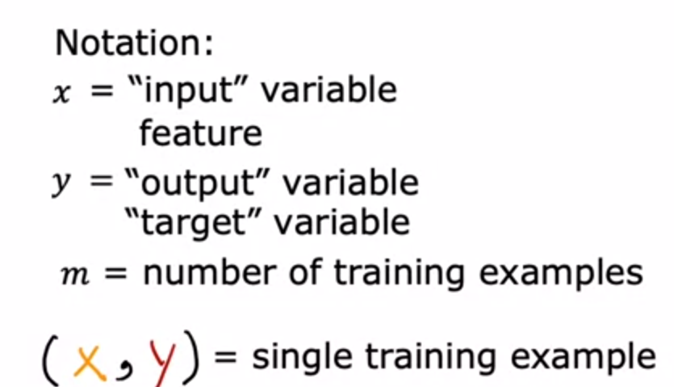
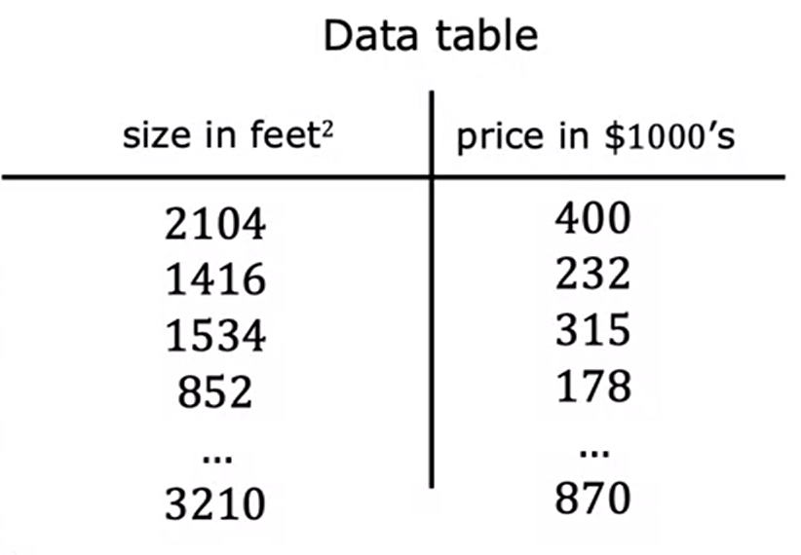
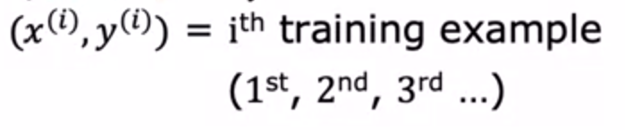
Data set

Slide 34
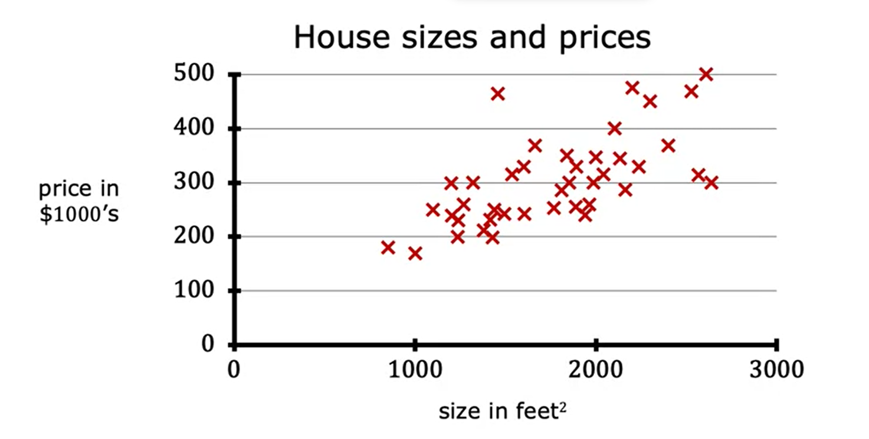
Linear regression problem

Slide 35
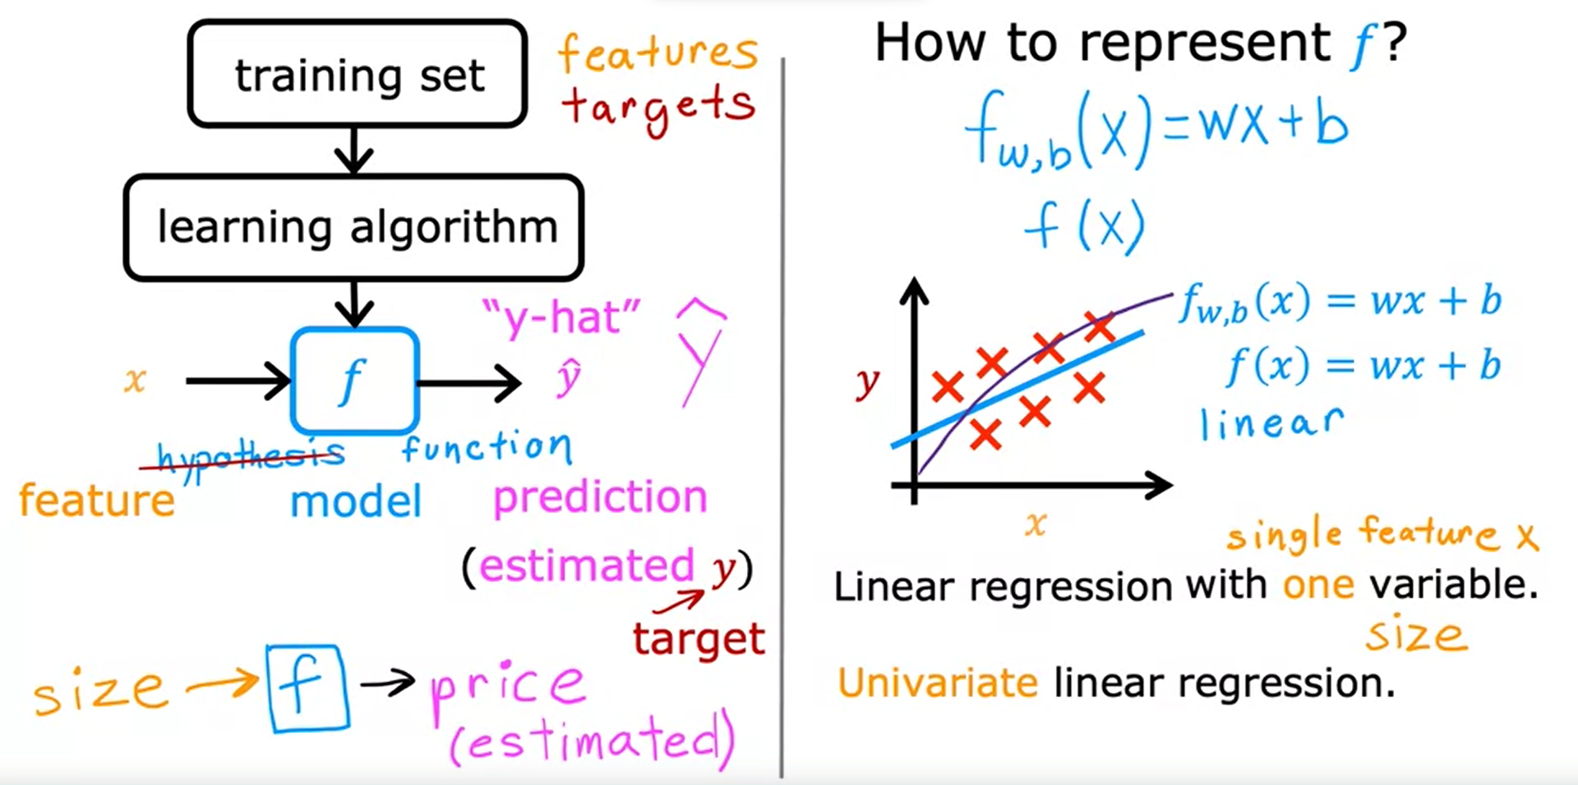

Linear regression problem

Slide 36
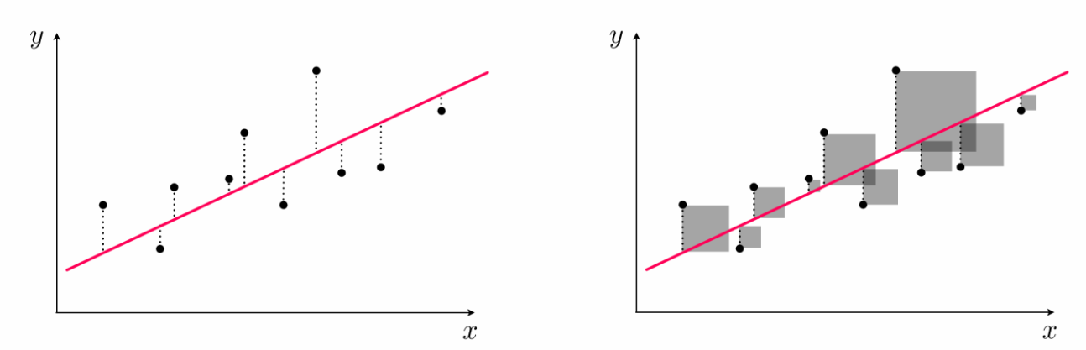

Slide 37
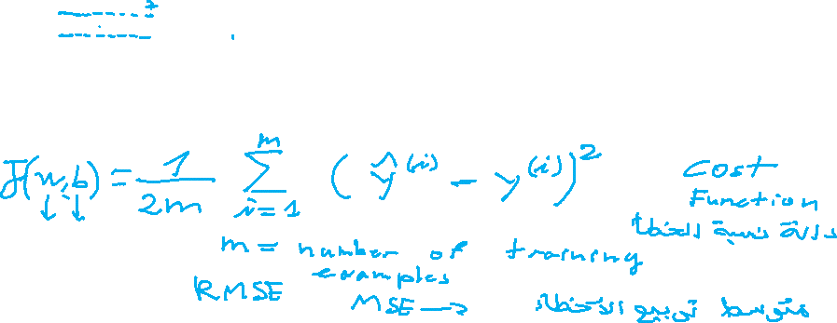

Slide 38
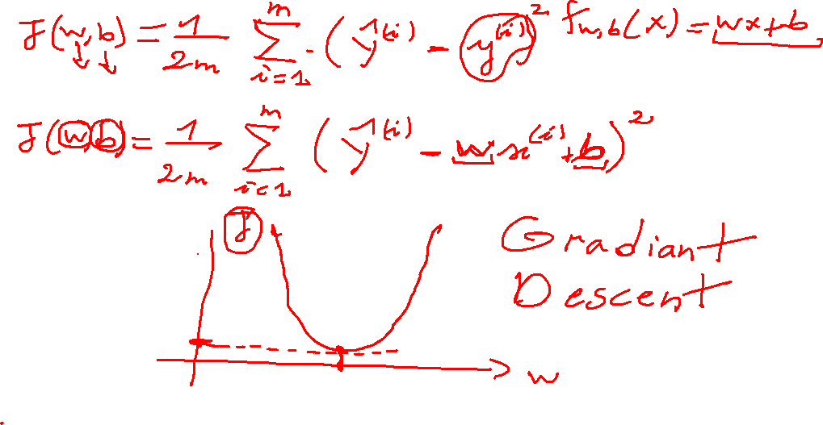

Slide 39
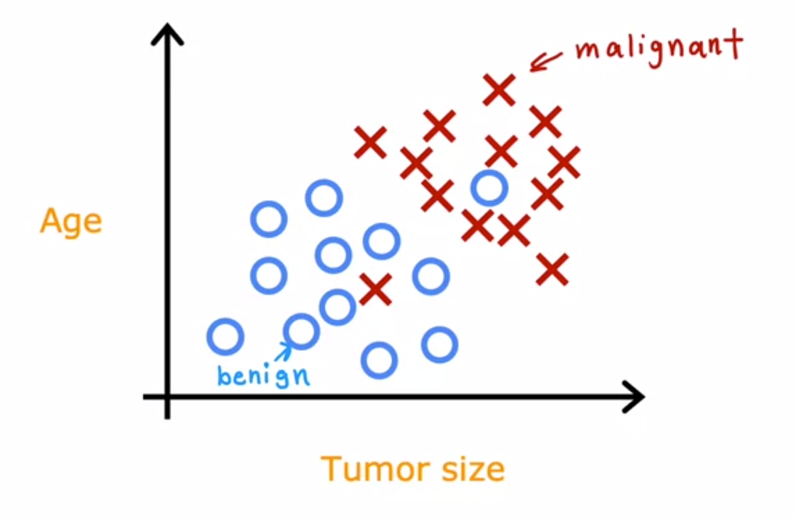
Classification problem

Slide 40
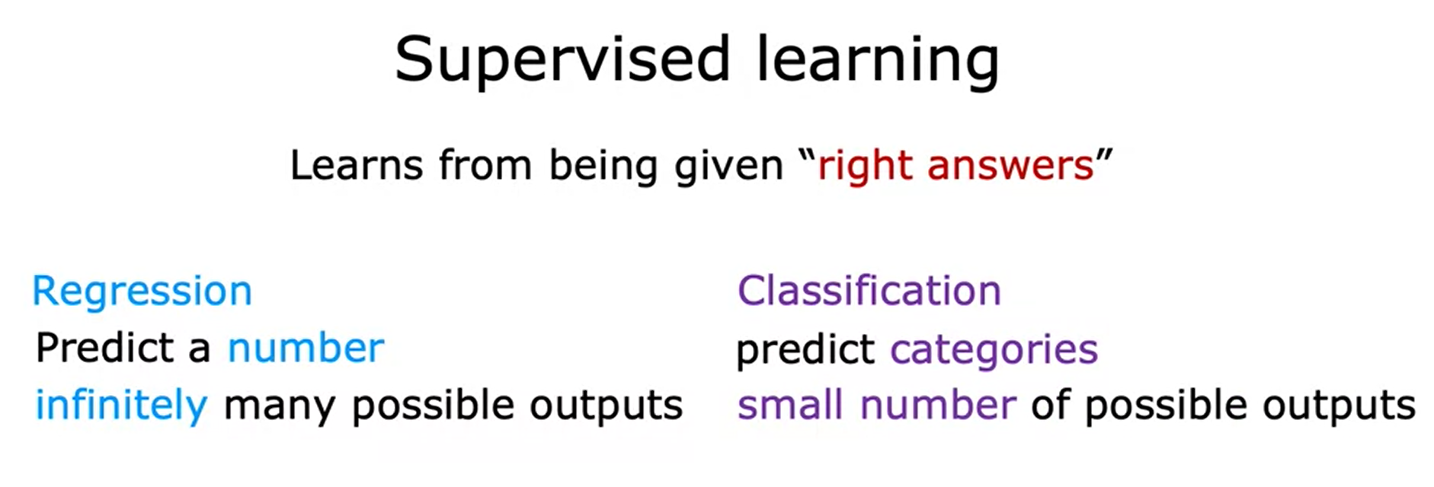
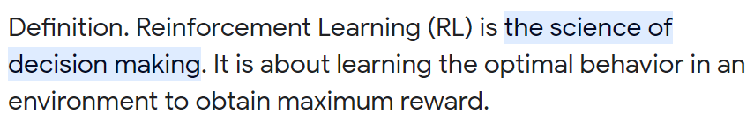


Slide 41
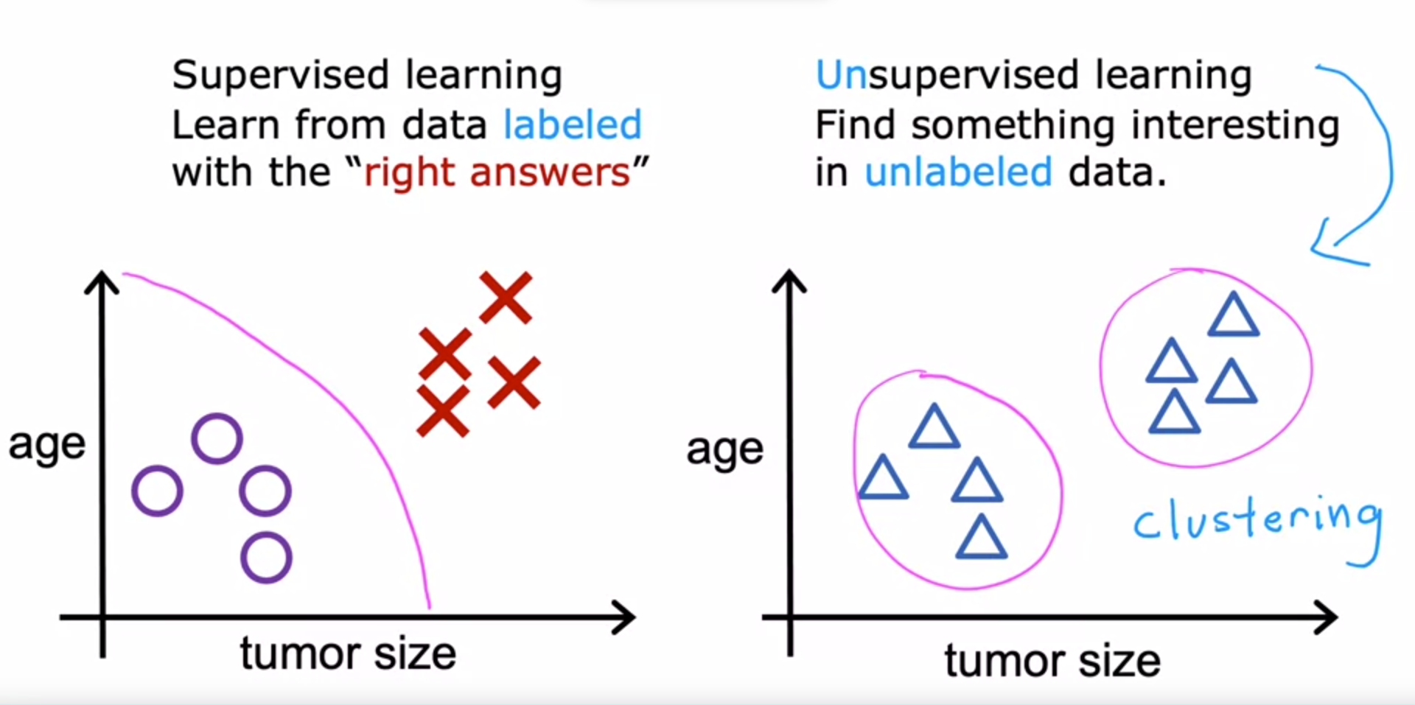
Unsupervised learning

Slide 42
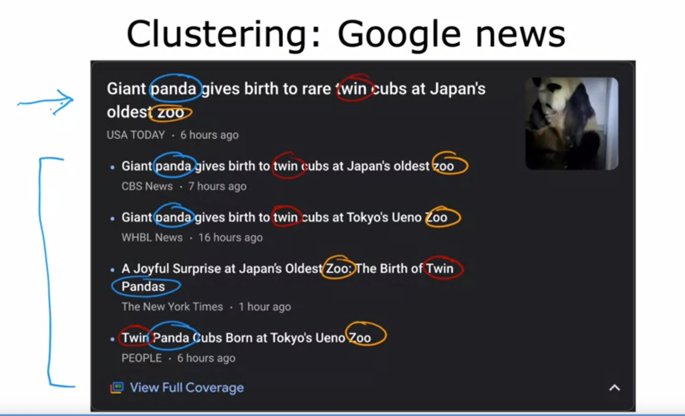
Unsupervised learning

Slide 43
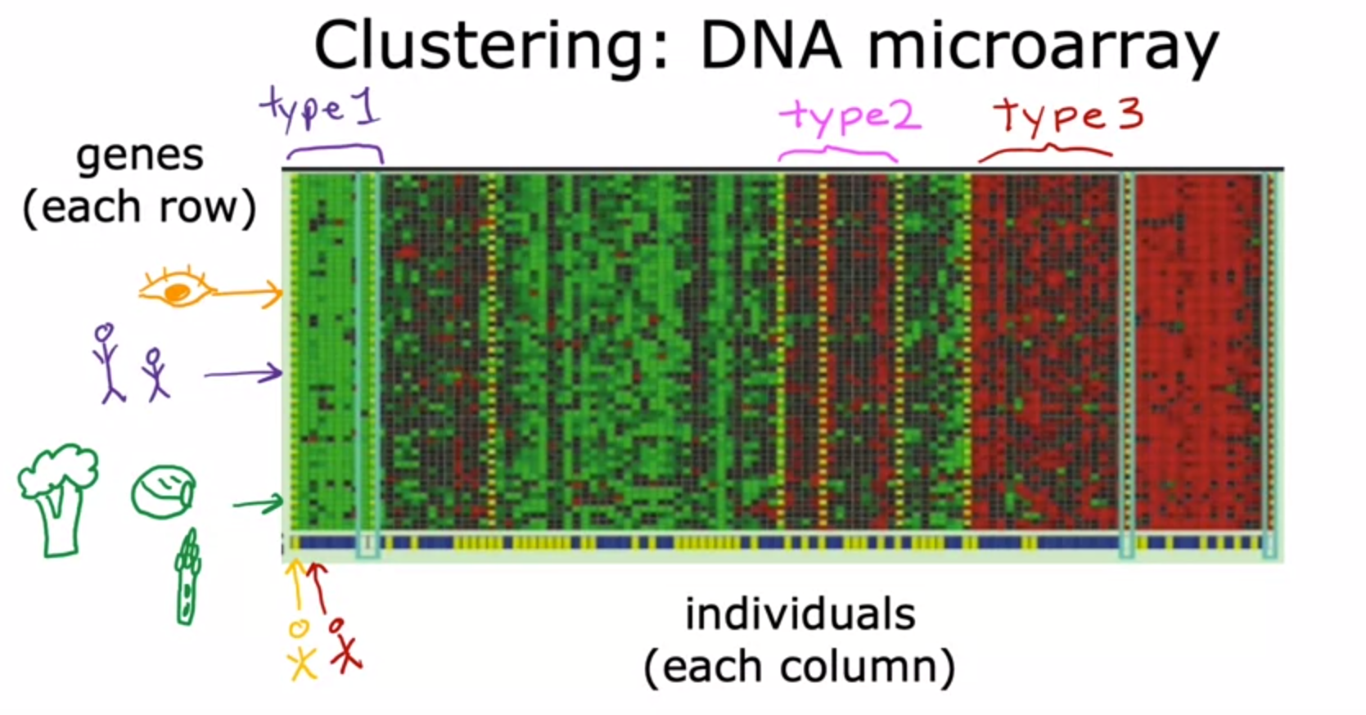
Unsupervised learning

Slide 44
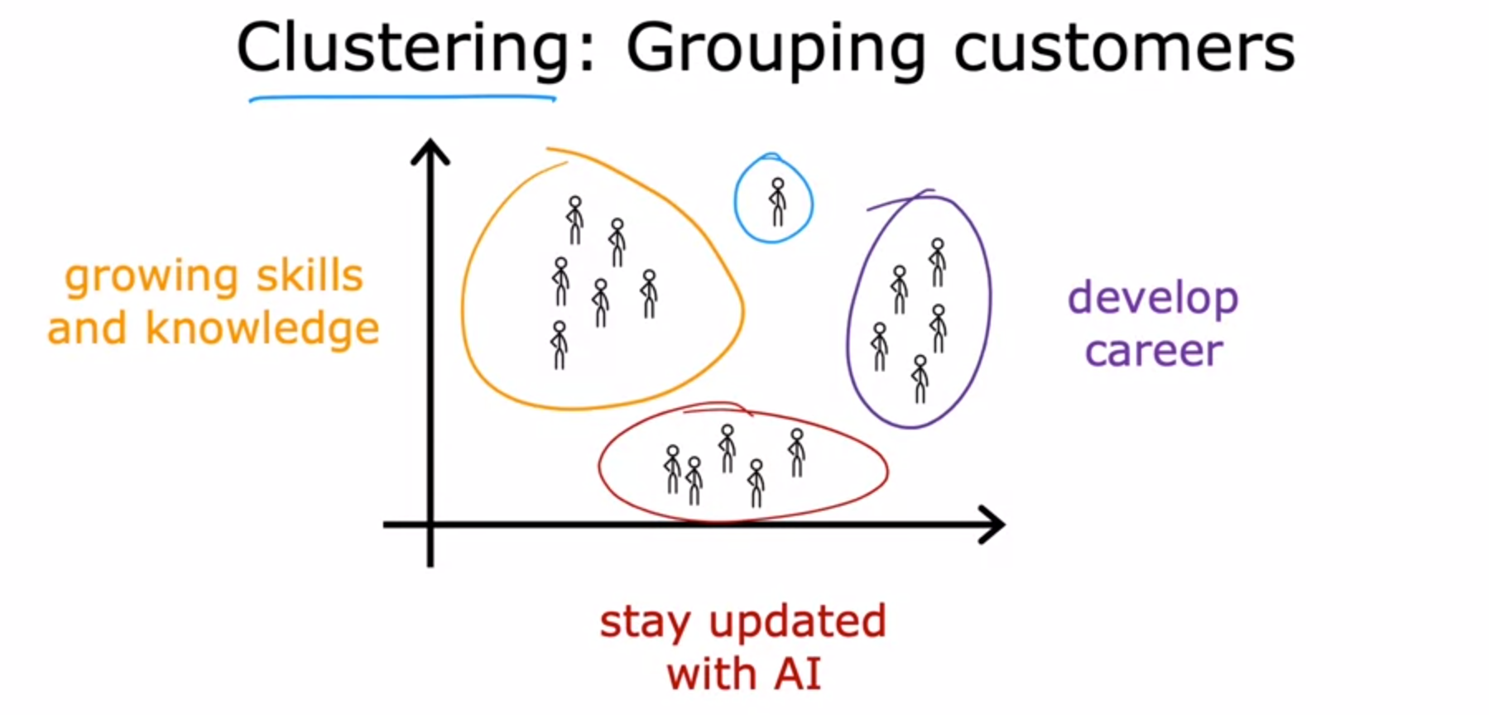
Unsupervised learning

Slide 45
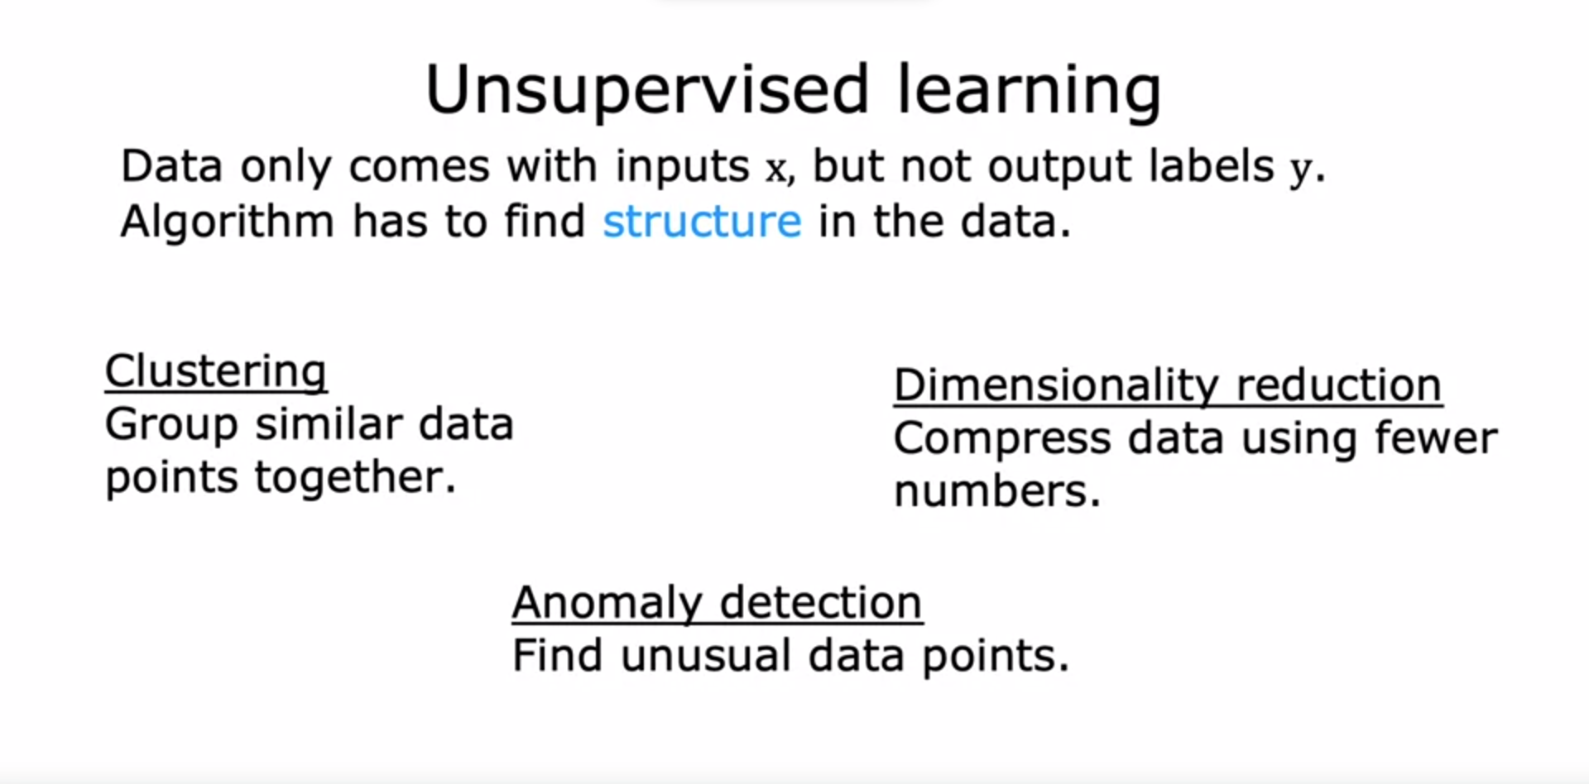

Slide 46
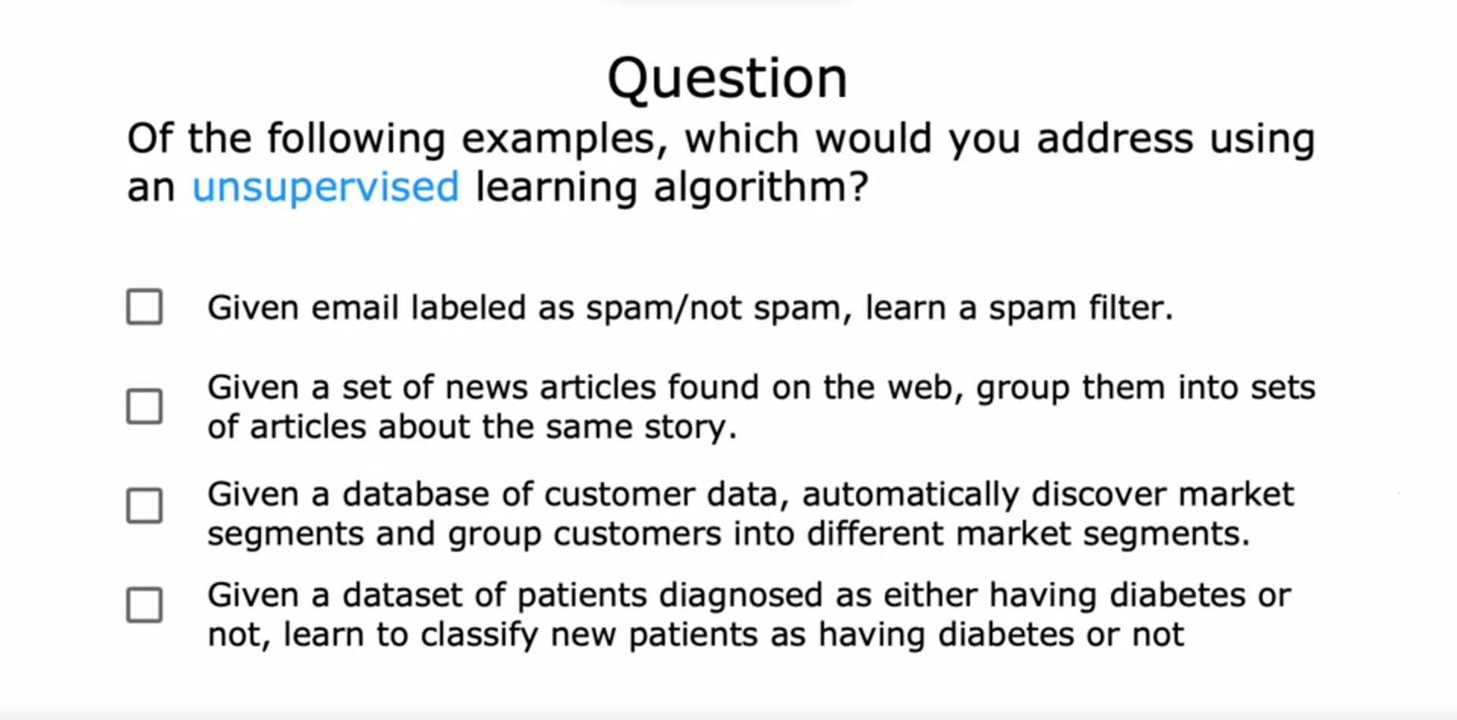

Slide 47
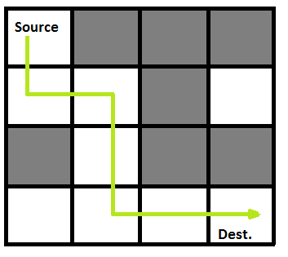
Reinforcement learning

Slide 48




Libraries and frameworks

Slide 49
Datasets

Slide 50
Data set
Unlabeled Datasets:
Purpose: Used for unsupervised learning tasks where the model must find patterns without labeled examples.
Characteristics: Contains data without corresponding target labels.
Labeled Datasets:
Purpose: Used for supervised learning tasks where the model is trained on input-output pairs.
Characteristics: Each example has associated target labels for training.

Slide 51
Data set
Training Datasets:
Purpose: Used to train machine learning models by exposing them to a large set of examples.
Characteristics: Typically the largest subset, containing labeled examples (input-output pairs).
Testing Datasets:
Purpose: Used to assess the performance of a trained model on unseen data.
Characteristics: Similar to training datasets but kept separate to evaluate generalization.
Validation Datasets:
Purpose: Employed during the training phase to fine-tune model parameters and prevent overfitting.
Characteristics: Separate from both training and testing datasets, used for model validation.

Slide 52
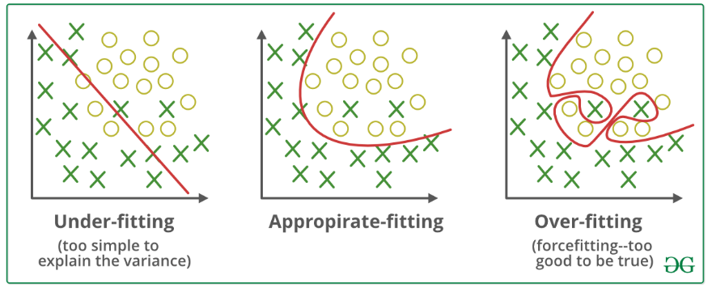
Overfitting and Underfitting

Slide 53
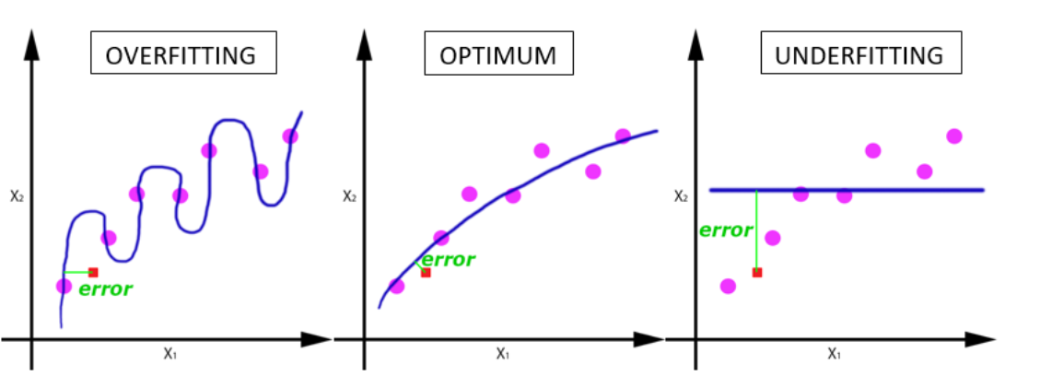
Over-fitting and Under-fitting

Slide 54
How to address overfitting?
Collect more data
Select features (insufficient data): feature selection
Reduced size of parameters (high powers): Regularization

Slide 55
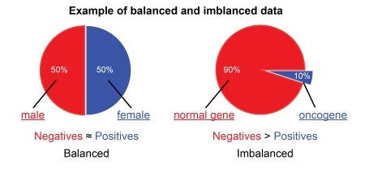
Data set
Imbalanced Datasets:
Purpose: Used to address situations where certain classes are underrepresented in the data.
Characteristics: The distribution of classes is uneven, posing challenges for model training.

Slide 56
Data set
Tabular Datasets:
A tabular dataset is a structured form of data organized in rows and columns, similar to a table in a relational database or a spreadsheet. Each row typically represents an individual record, observation, or data point, while each column contains a specific attribute or feature describing the characteristics of those data points. Tabular datasets are commonly used in various fields, and they are particularly suitable for machine learning tasks where each data point is described by a set of features.
Image Datasets:
Purpose: Used for computer vision tasks.
Characteristics: Contains images with corresponding labels (e.g., object detection, image classification).
Text Datasets:
Purpose: Used for natural language processing (NLP) tasks.
Characteristics: Includes textual data, such as articles, books, or social media posts, with labeled or unlabeled examples.

Slide 57
Data set
Audio Datasets:
Purpose: Used for tasks involving sound data, such as speech recognition or audio classification.
Characteristics: Includes audio recordings with corresponding labels.
Reinforcement Learning Datasets:
Purpose: Used for training agents in reinforcement learning tasks.
Characteristics: Typically involves a sequence of states, actions, and rewards.
Transfer Learning Datasets:
Purpose: Used to pre-train models on a large dataset before fine-tuning on a specific task.
Characteristics: Large and diverse datasets suitable for general feature learning.

Slide 58
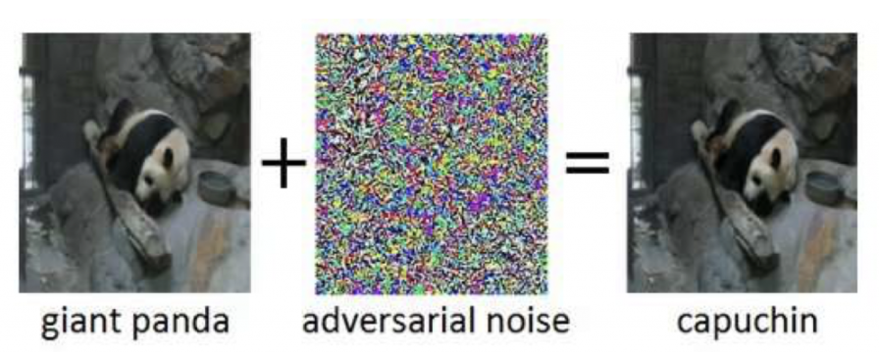
Data set
Adversarial Datasets:
Purpose: Used to train models that are robust to adversarial attacks.
Characteristics: Includes examples specifically crafted to mislead the model.

Slide 59
Gradient descent

Slide 60
Deep Learning

Slide 61
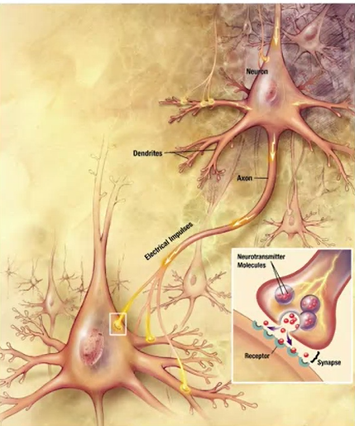
Neurons and the Brain

Slide 62
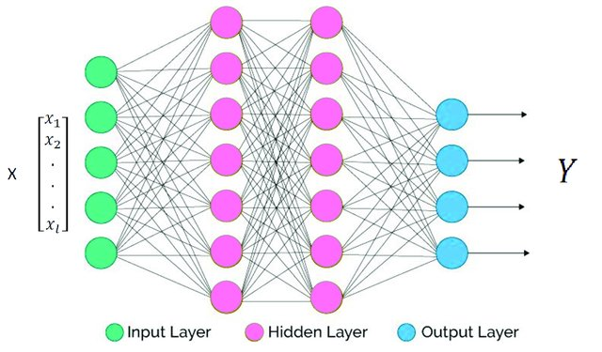
Artifical Neural Network

Slide 63
Artifical Neural Network
Neurons
Layers
Forward propagation
Backward propagation
Activation functions
Cost functions

Slide 64
Hyper-parameters
Learning Rate:
Role: Determines the step size at each iteration while moving toward a minimum of a loss function. It affects the convergence and stability of the training process.
Example: 0.001, 0.01, 0.1.
Number of Hidden Layers and Units:
Role: Specifies the architecture of the neural network, including the number of layers and the number of neurons in each layer.
Example: Two hidden layers with 64 and 128 units.

Slide 65
Hyper-parameters
Activation Functions:
Role: Defines the mathematical operation applied to each neuron's output. Common activation functions include ReLU, sigmoid, and tanh.
Example: ReLU (Rectified Linear Unit), Sigmoid.
Batch Size:
Role: Determines the number of training examples utilized in one iteration. Affects the speed and memory requirements during training.
Example: 32, 64, 128.

Slide 66
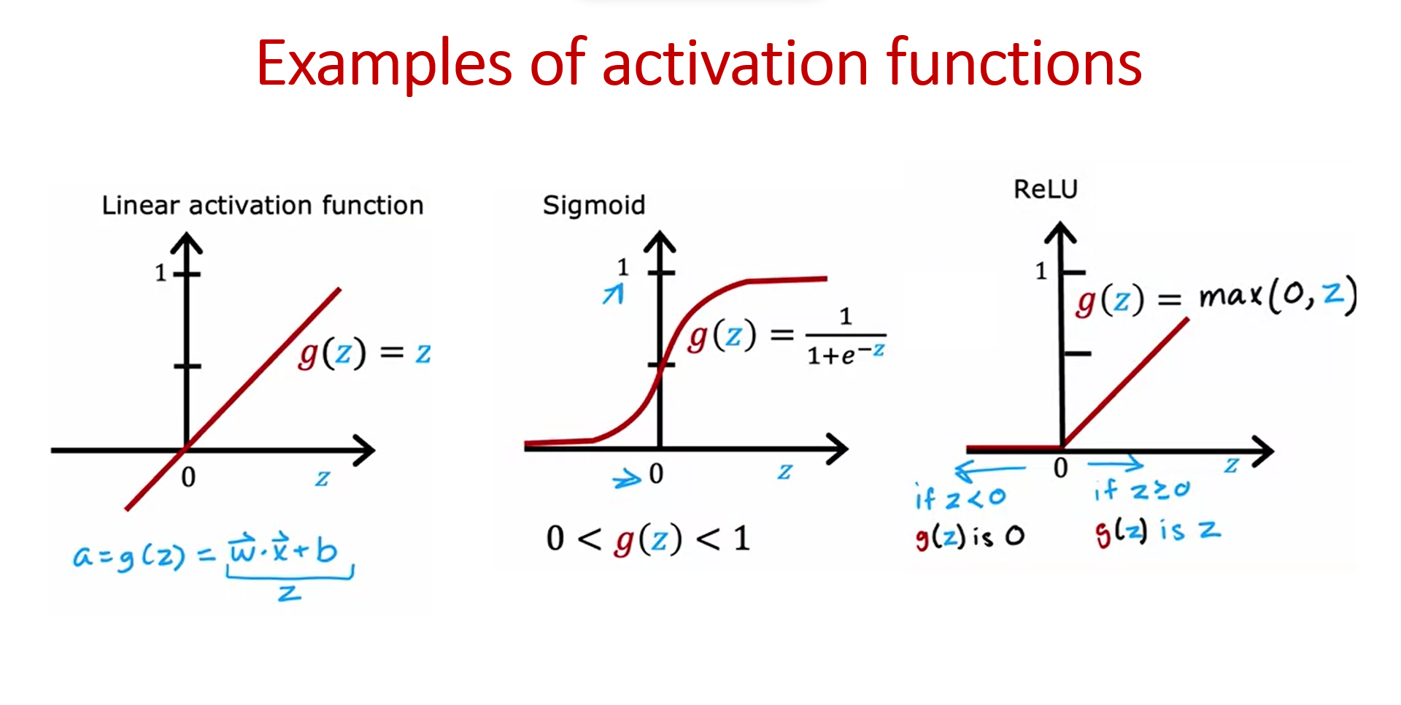
Hyper-parameters

Slide 67
Hyper-parameters
Epochs:
Role: Represents the number of times the learning algorithm will work through the entire training dataset. Affects the number of iterations during training.
Example: 10, 50, 100.
Regularization Strength (e.g., L1 or L2 regularization):
Role: Controls the penalty applied to the model's complexity, helping prevent overfitting.
Example: 0.01, 0.1, 1.0.

Slide 68
Hyper-parameters
Dropout Rate:
Role: Determines the fraction of neurons to randomly drop out during training, preventing over-reliance on specific neurons and enhancing generalization.
Example: 0.2, 0.5.
Optimizer:
Role: Specifies the optimization algorithm used to minimize the loss function during training. Common optimizers include stochastic gradient descent (SGD), Adam, and RMSprop.
Example: SGD, Adam.

Slide 69
Hyper-parameters
Adjusting hyperparameters is often an essential part of model development, and finding the right combination of hyperparameter values is crucial for achieving optimal model performance. This process is often done through techniques such as grid search or random search, where different combinations of hyperparameter values are systematically explored and evaluated.

Slide 70



Libraries and frameworks

Slide 71
Computer Vison
(CV)

Slide 72



Libraries and frameworks

Slide 73
Computer vision
Definition: Computer Vision is a field of artificial intelligence that enables machines to interpret and understand visual information from the world. It involves tasks such as image recognition, object detection, image segmentation, and facial recognition.

Slide 74
Computer vision
Image Classification: Assigning labels to images based on their content.
Object Detection: Identifying and locating objects within an image.
Image Segmentation: Dividing an image into meaningful segments.
Facial Recognition: Identifying and verifying individuals based on facial features.
Convolutional Neural Networks (CNNs): Deep learning architectures commonly used in computer vision.
Image Generation: Creating new images, often using Generative Adversarial Networks (GANs).

Slide 75
Computer vision
Applications:
Autonomous Vehicles: Object detection and scene understanding for self-driving cars.
Medical Imaging: Diagnosing diseases from medical images.
Surveillance: Monitoring and analyzing video feeds for security.
Augmented Reality: Integrating computer-generated information with the real-world environment.

Slide 76
Natural Language Processing (NLP)

Slide 77
Natural Language Processing (NLP)
Definition: Natural Language Processing is a subfield of AI that focuses on the interaction between computers and human language. It involves the analysis and understanding of natural language, enabling machines to comprehend, interpret, and generate human-like text.

Slide 78
Natural Language Processing (NLP)
Text Classification: Assigning labels or categories to text documents.
Named Entity Recognition (NER): Identifying and classifying entities (e.g., names, locations) in text.
Sentiment Analysis: Determining the sentiment expressed in text (positive, negative, neutral).
Machine Translation: Translating text from one language to another.
Question-Answering Systems: Generating answers to user queries.
Transformer Models: Deep learning models like BERT and GPT that revolutionized NLP.

Slide 79
Natural Language Processing (NLP)
Applications:
Chatbots: Conversational agents for customer support or information retrieval.
Language Translation: Translating text between languages.
Summarization: Generating concise summaries of large text documents.
Sentiment Analysis: Analyzing public opinion from social media or customer reviews.

Slide 80
Generative AI

Slide 81
Generative Ai
Definition: Generative AI involves creating models that can generate new content, whether it be images, text, or other types of data. It often employs techniques like Generative Adversarial Networks (GANs) or autoregressive models.

Slide 82
Generative Ai
Generative Adversarial Networks (GANs): A type of neural network architecture with a generator and a discriminator.
Autoregressive Models: Models that generate data one element at a time in a sequential manner.
Variational Autoencoders (VAEs): Models that learn to encode and generate data distributions.

Slide 83
Generative Ai
Applications:
Image Generation: Creating realistic images that did not exist before.
Text Generation: Generating coherent and contextually relevant text passages.
Style Transfer: Transforming the style of content, such as turning a photo into a painting.
Data Augmentation: Creating diverse training datasets for machine learning models.

Slide 84
Resources
Coursera: Machine Learning Specialization, Andrew NG
Coursera: Deep Learning Specialization, Andrew NG
Books:
Hands-on machine learning, Aurélien Géron, 3rd edition
Deep learning With python, Francois Chollet, 2nd edition
Deeplearningbook.org : MIT e-book
YouTube:
Cs231 2016 YouTube playlist
StatQuest
Kaggle

Slide 85
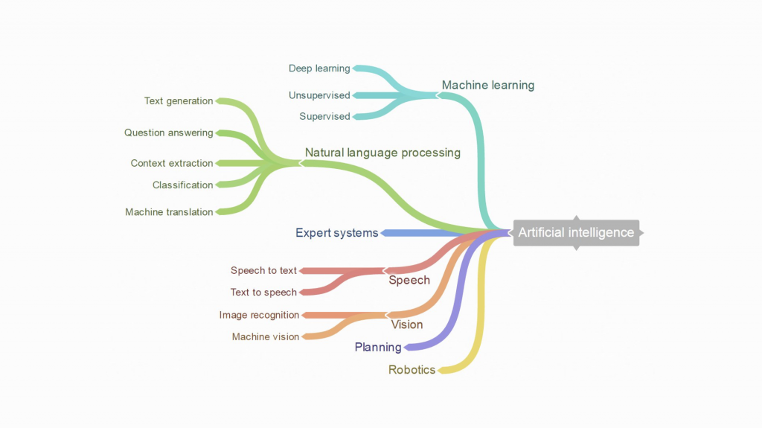
Recap

Slide 86


Slide 87
Contact me:
Fb: Oussama Boussahla
Linkedin: Oussama BOUSSAHLA
Instagram: b.oussama8
E-mail: oussamaboussahl2017@gmail.com
Telegram: @boussahlaoussama

